Slide 1
Medical Alert Information in FHIR
Uppmärksamhetsinformation (UMI)

Slide 2
Agenda
Medical alert information in Sweden
  About
  Example implementations
Working group ”UMI on FHIR”
  About
  Aim
  Approach
Implementation guide
  Profiles, extensions & value sets
  Example XML
  Use case description
  Mappings
  Translations
Instructions FHIR Hackathon

Slide 3
Medical Alert Information in Sweden
About
Sweden’s National Board of Health and Welfare (NBHW) has developed an information specification for medical alert information which contains a nationally agreed description of medical alert information
The information is
    structured based on the national information structure and national information sets
    expressed with uniform terms and associated codes from the Swedish version of Snomed CT and the ICD-10-SE and ATC classifications
The information should serve as a basis for the implementation of medical alert information in healthcare information systems
Notes:
The information on this slide is a direct translation of the NBHW’s description of the information specification for medical alert information on Uppmärksamhetsinformation – Socialstyrelsen
National Board of Health and Welfare: Startpage – Socialstyrelsen
Medical Alert Information as defined by Swedens National Board of Health and Welfare: Uppmärksamhetsinformation - Socialstyrelsen

Slide 4
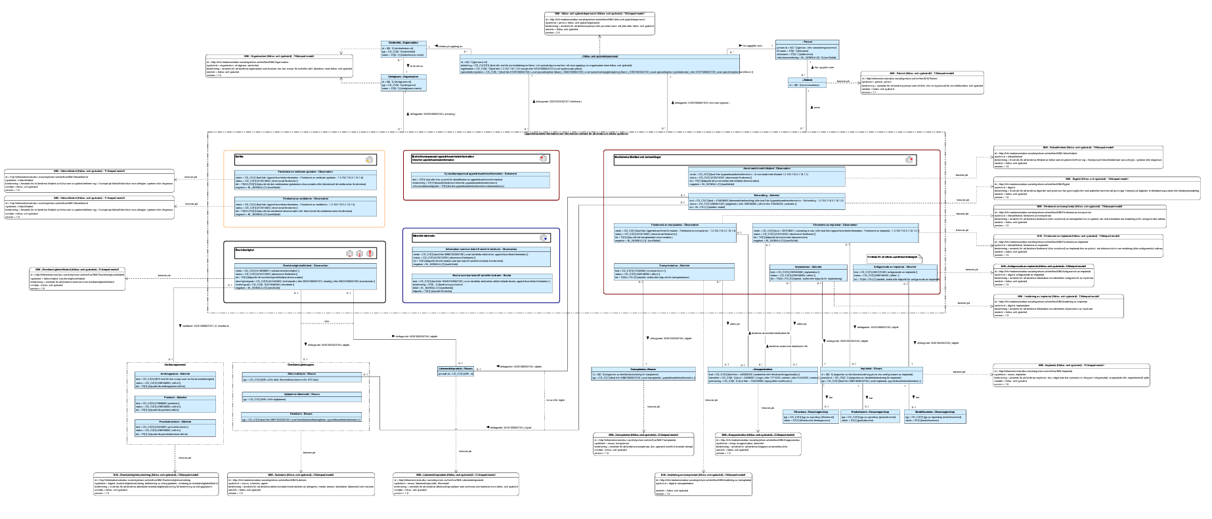
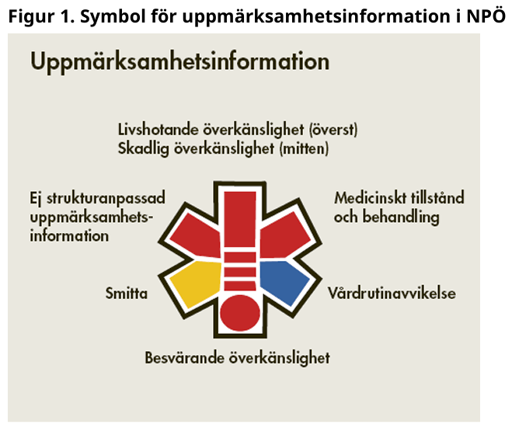
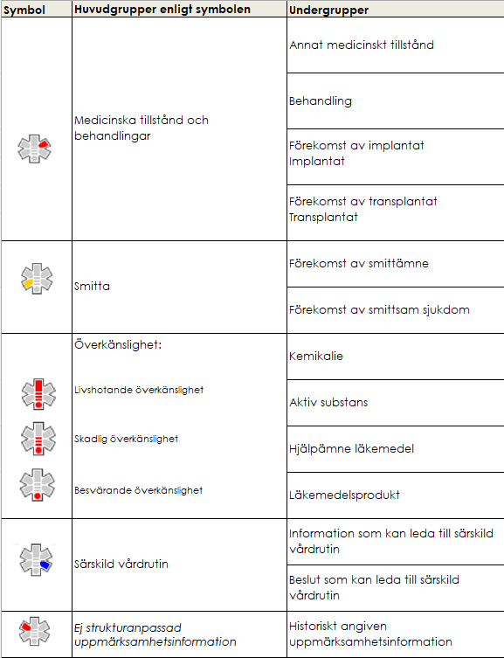
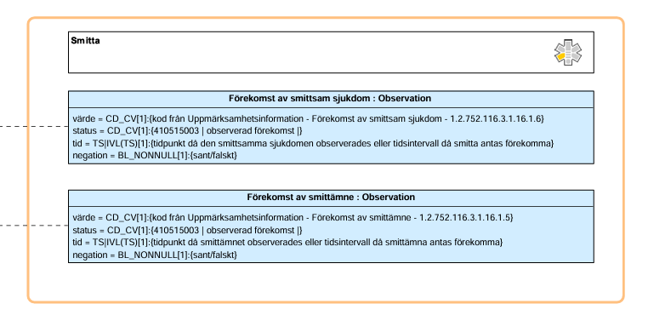
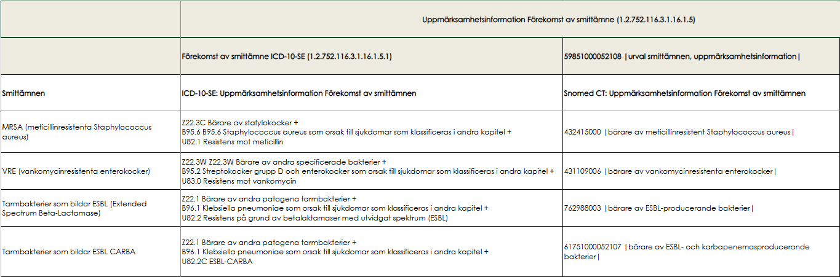
Medical Alert Information in Sweden
About
Notes:
Information specification contains concept model and information model that describe medical alert information. Accompanied by code list
Groups and subgroups of medical alert information (
Medicinska tillstånd och behandlingar - Medical condition and treatments
Smitta - Contagian
Information that needs to be handled per subgroup, specified by attributes
Codes relevant for attributes of datatype coded value (Snomed CT, ATC etc)

Slide 5
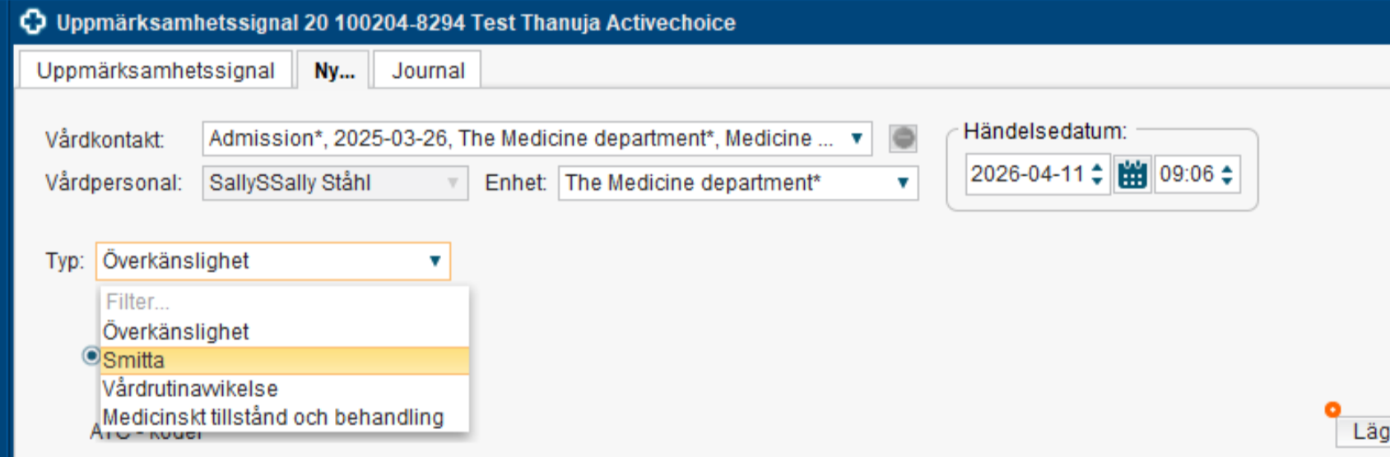
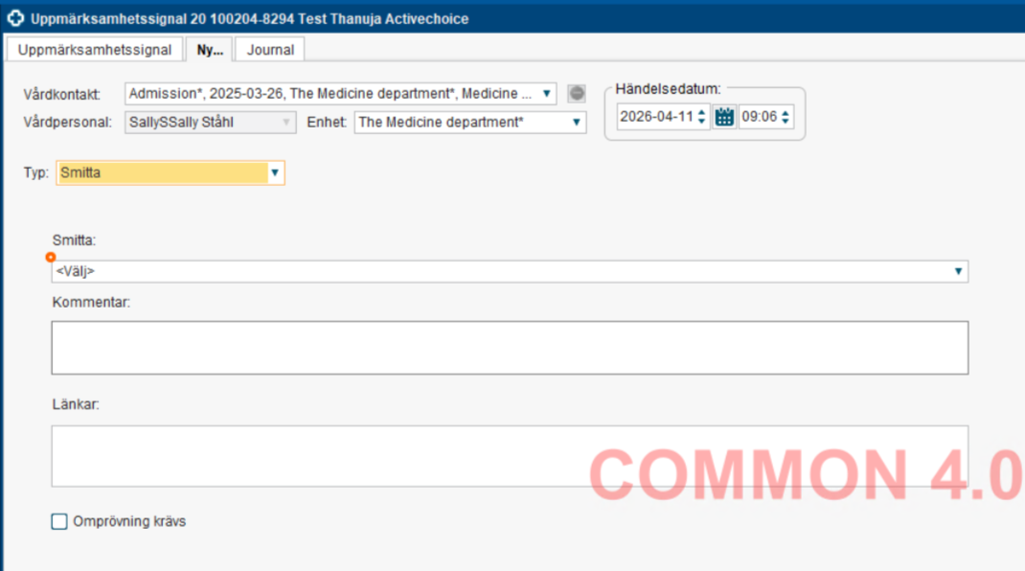
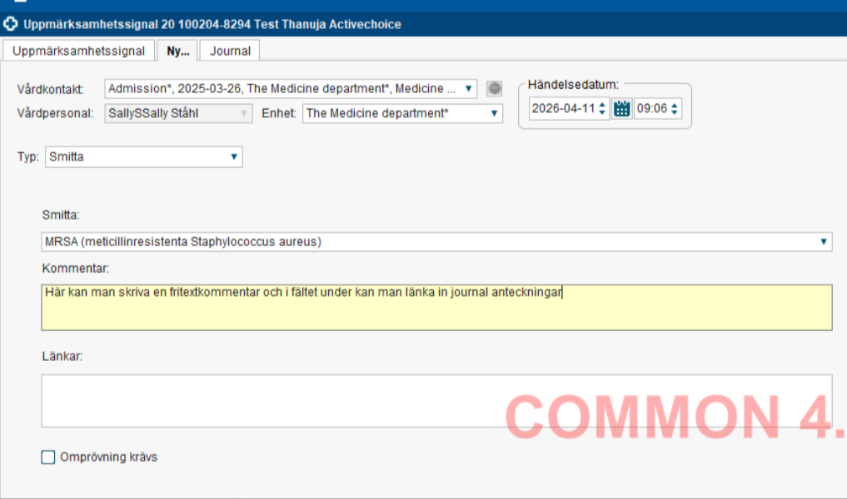
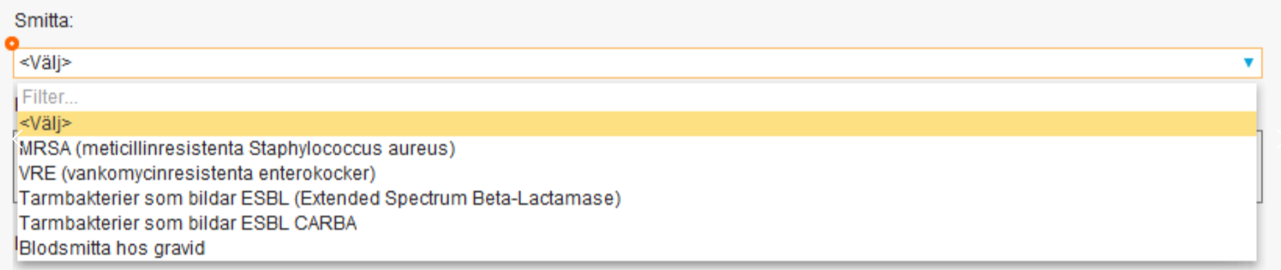
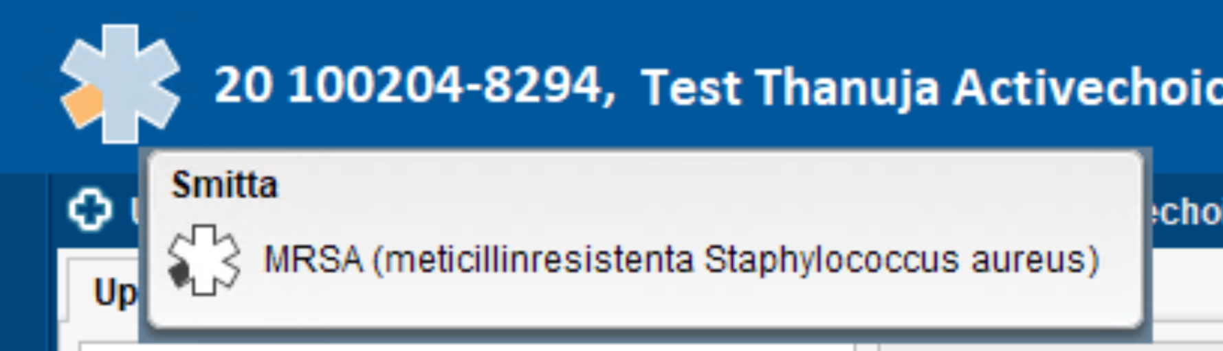
Medical alert information
Example implementation: Cosmic

Slide 6
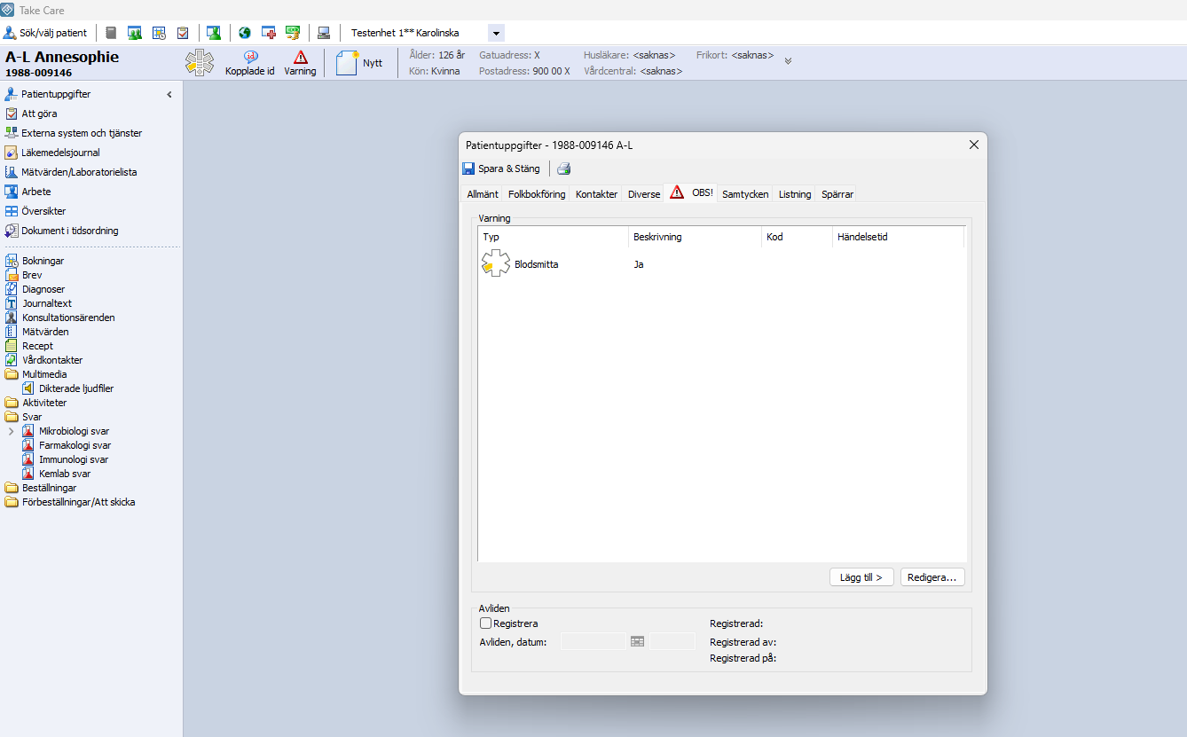
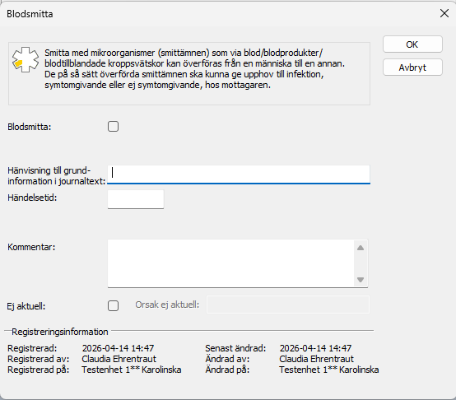
Medical alert information
Example implementation: TakeCare
Not aligned with latest version of NBHW’s information specification for medical alert information!

Slide 7
Working group ”UMI on FHIR”
About
Formed in 2024 (as part of several working groups under HL7 Sweden)
Consists of representatives from several stakeholders, e.g.
  Swedish regions
  Healthcare information system suppliers
Notes:
Medical Alert Information - HL7 Sweden – Confluence

Slide 8
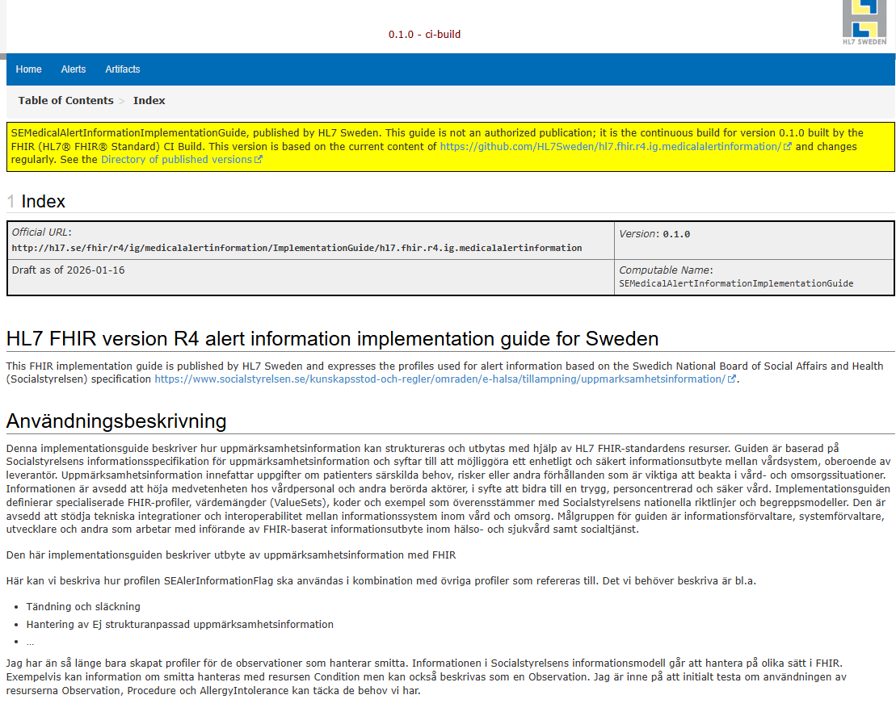
Working group ”UMI on FHIR”
Aim
Create an implementation guide that describes realization of medical alert information in FHIR
Notes:
Medical Alert Information - HL7 Sweden – Confluence
Index - v0.1.0

Slide 9
Working group ”UMI on FHIR”
Approach
Base work on latest version of the NBHW’s information specification for medical alert information
Take the work done in Norway inte account, i.e., Kritisk Informasjon - NHN Utviklerportal
Use FHIR resurs Flag plus extensions in R4
Document work on Medical Alert Information - HL7 Sweden - Confluence
Notes:
Flag - FHIR v4.0.1

Slide 10
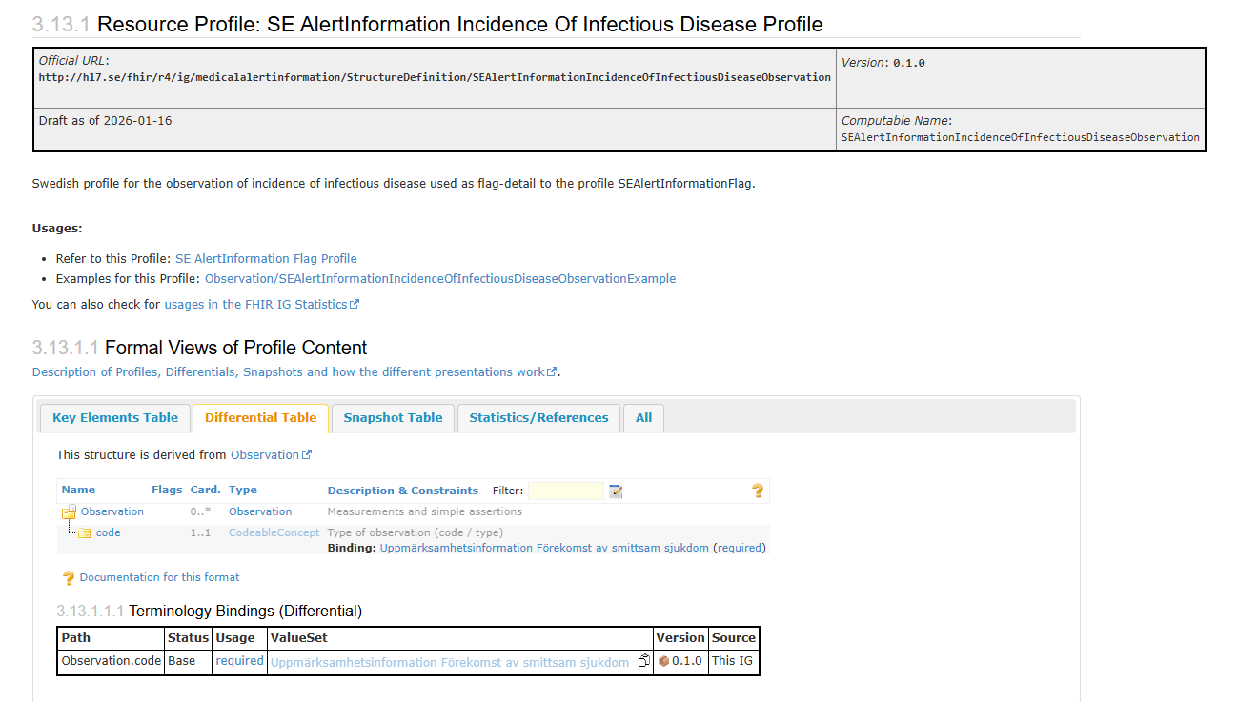
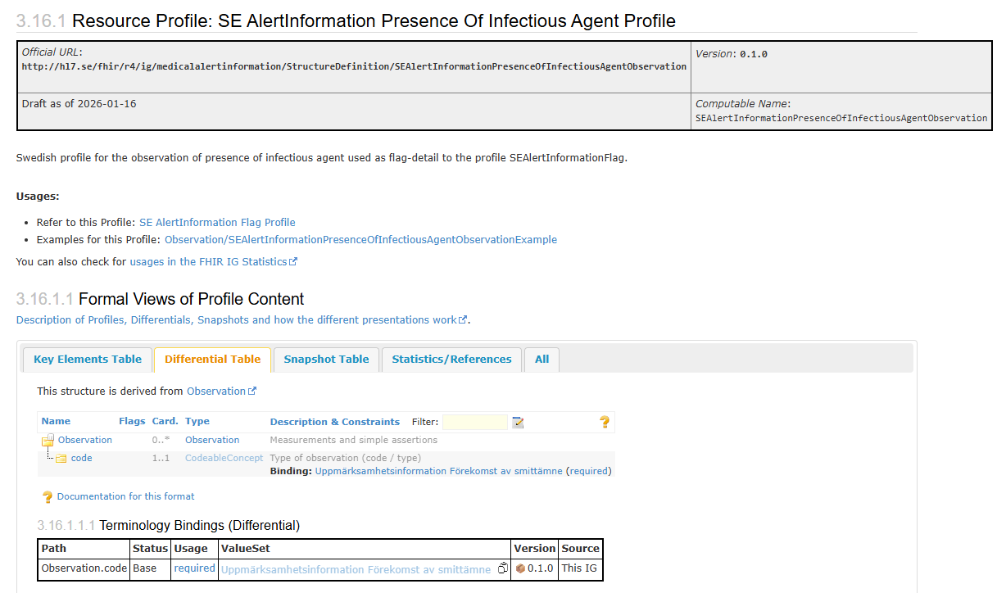
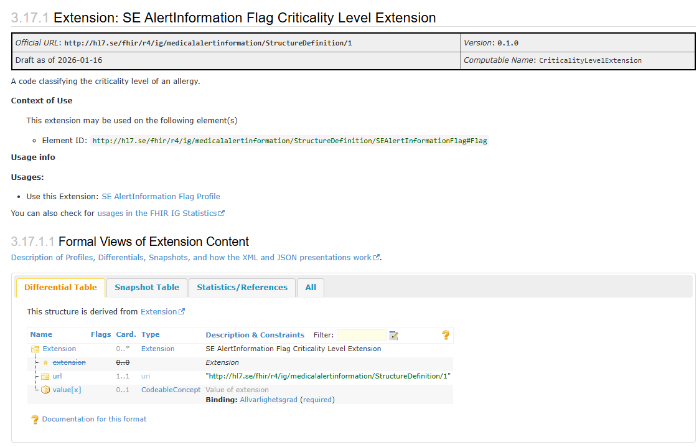
Implementation Guide
Profiles, extensions and value sets
One profile per subgroup, e.g. for
  infectious disease
  Infectious agent
Value set for codes per subgroup
Extension for criticality level
Notes:
Artifacts Summary - v0.1.0

Slide 11
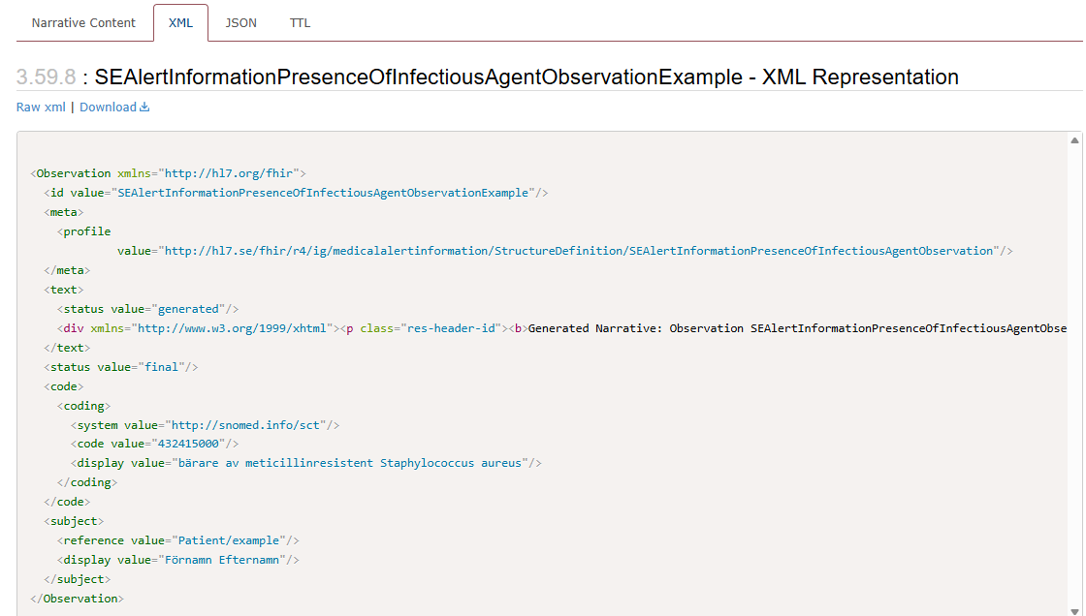

Implementation Guide
Example XML for infectious agent
Notes:
Lägg in symbol för smitta

Slide 12
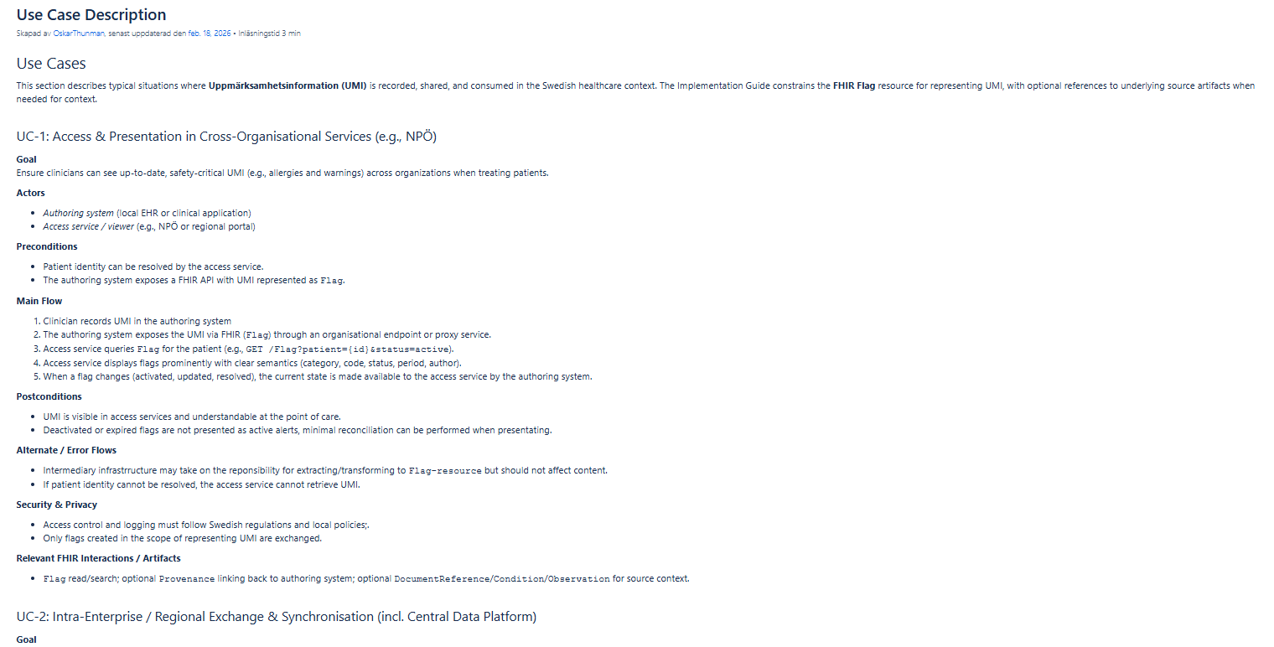
Implementation Guide
Use case description
Notes:
Use Case Description - HL7 Sweden - Confluence

Slide 13
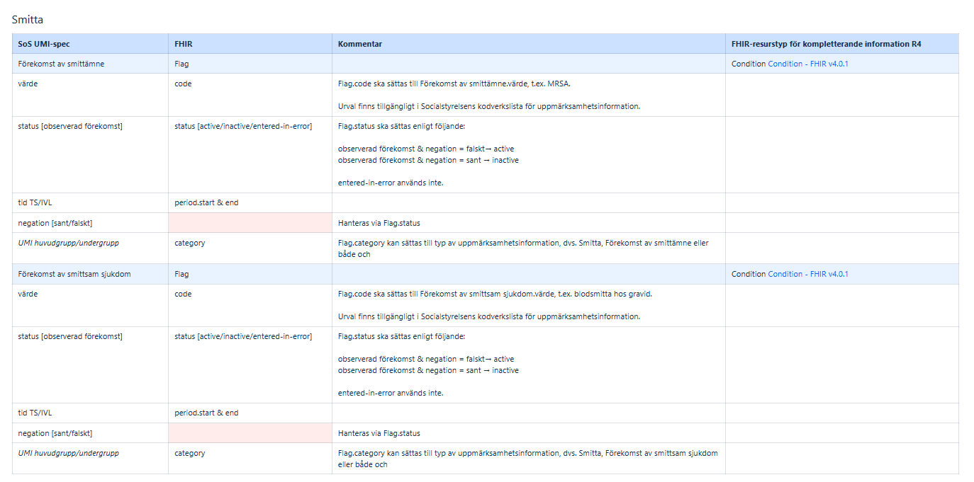
Implementation Guide
Mappings
Notes:
Mappning UMI informationsspecifikation och FHIR - HL7 Sweden - Confluence

Slide 14
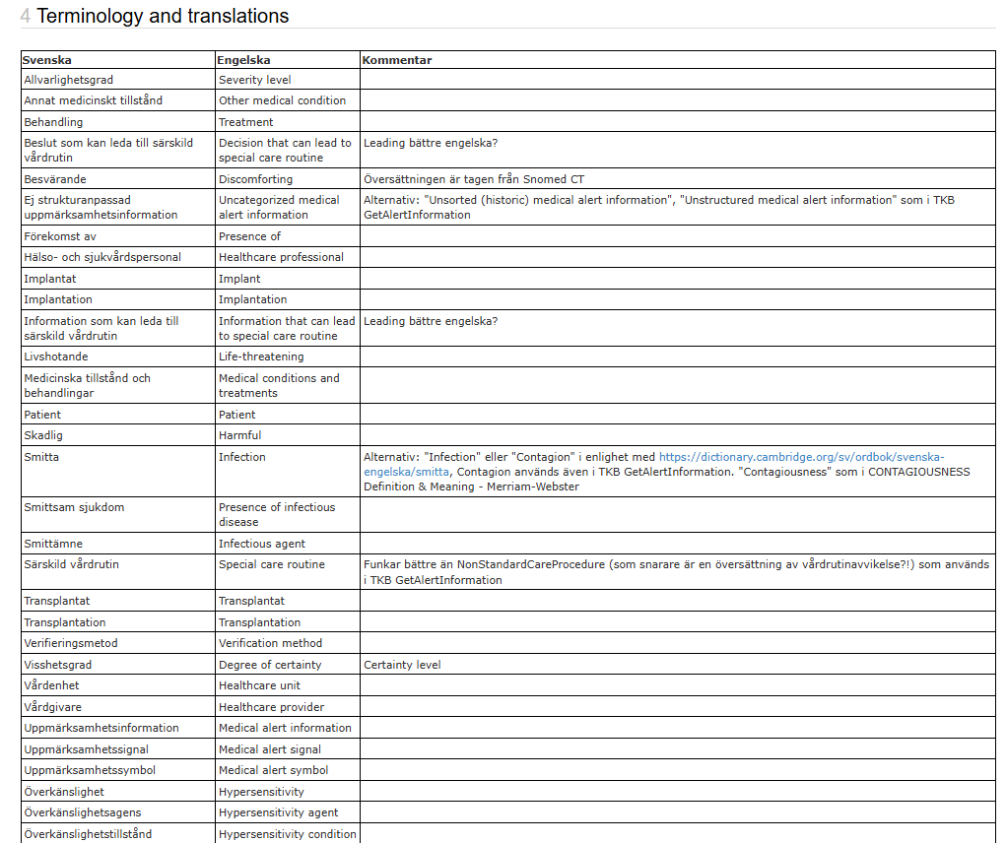
Implementation Guide
Translations
Notes:
Översättningar - HL7 Sweden - Confluence

Slide 15
Medical alert information and openEHR
Working group
Formed in 2022
Consists of representatives from several stakeholders (mainly the Swedish regions and healthcare information system suppliers)
Aim is to create
  a template and
  an associated implementation guide
Approach
  Base work on NBHW’s information specification for medical alert information
  Take the work done in Norway into account, i.e., the template Kritisk informasjon i Kjernejournal

Slide 16
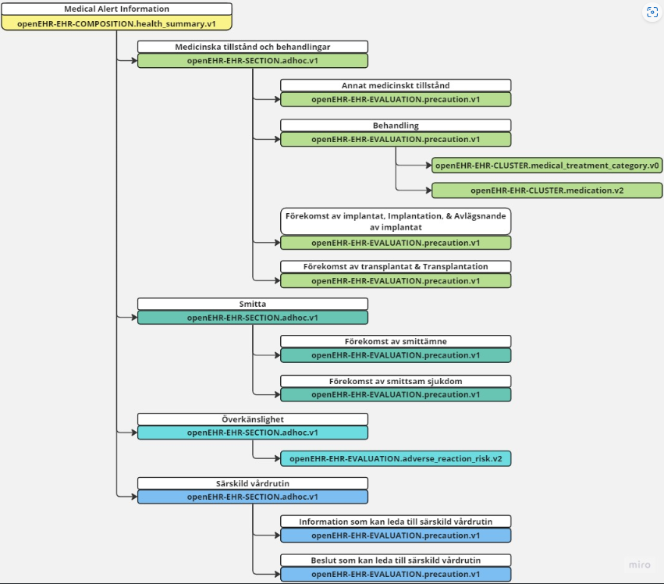
Medical alert information and openEHR
Template and implementation guide (IG)
First version of template and IG are created
  Template: Release UMI_template.1.0.0-alpha.1 · modellbibliotek/CKM-mirror
  IG: Uppmärksamhetsinformation i openEHR

Slide 17
Mappning to IPS and EPS/EHDS
Mapping to the International Patient Summary (IPS) was done?
Mapping to the European Patient Summary (EPS)/EHDS will be done during 2026 by the UMI/EHDS working group under the National Council for Interoperability
Notes:
Fyll på med mappning från Oskar
Uppdragsbeskrivningar arbetsgrupper 2026 - Nationellt råd för interoperabilitet inom hälso- och sjukvård - Confluence

Slide 18
Instructions FHIR Hackathon
Task
Post, update, get or delete instances of medical alert information
Help for performing task
HAPI-server with imported profiles and example data can be found at: https://umi.infopeak.se/fhir
Demo page (i.e. example client that calls HAPI-server to retrieve and display information): https://demo.umi.infopeak.se/
Implementation guide (with information on profiles and use cases) can be found at: Index - v0.1.0

